Slide 1
BA WORDCLOUD
INTERESTING FINDING FROM CUSTOMER REVIEWS
2022

Slide 2
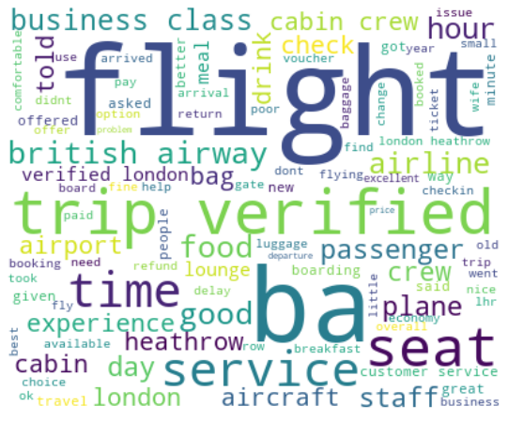
Wordcloud results

